Slide 1
TOF input
11-06-2024

Slide 2
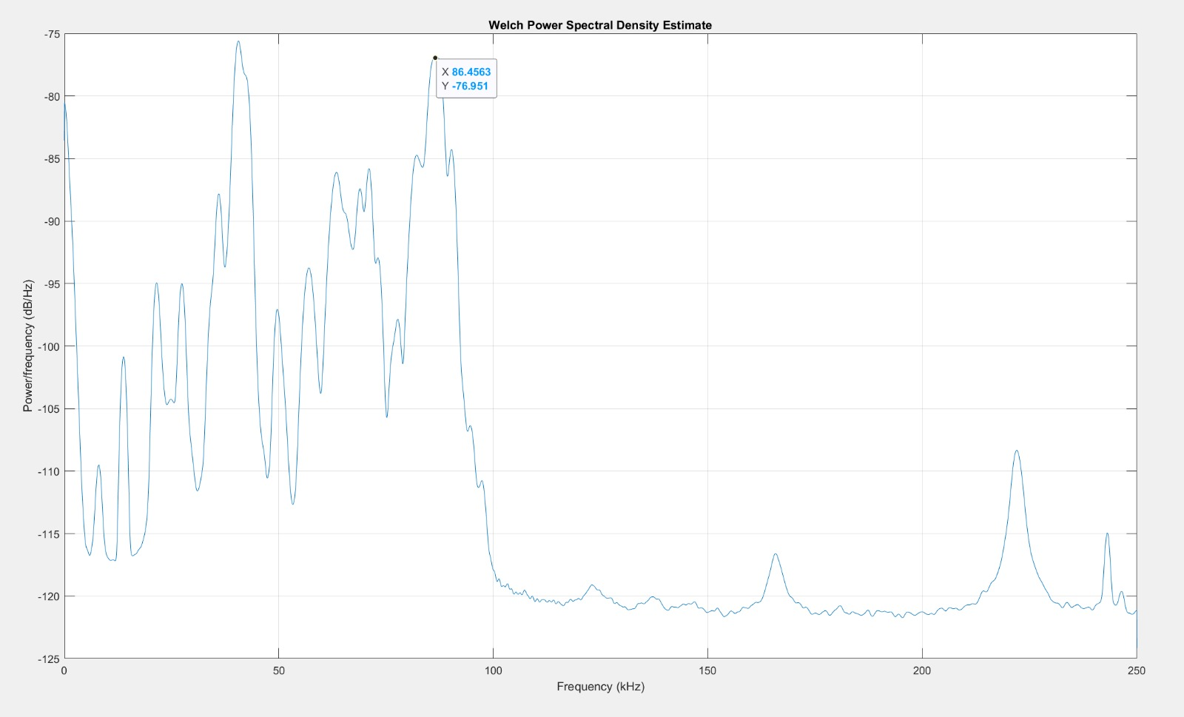
Block wave input frequencies
225.5 kHz
86.5 kHz
40.4 kHz

Slide 3
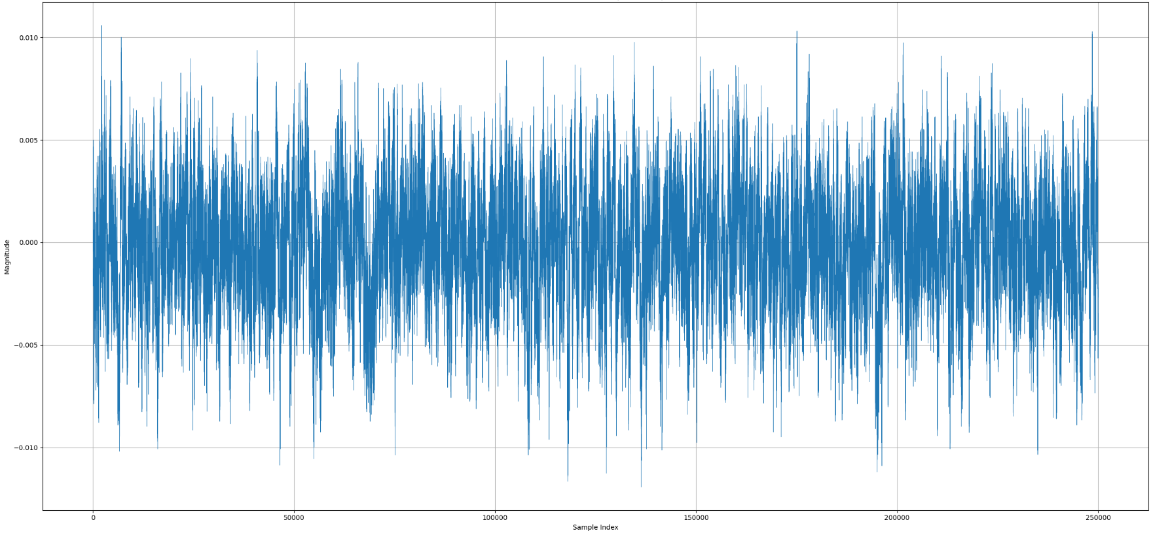
225.5kHz block wave 10 cycles
Not enough power

Slide 4
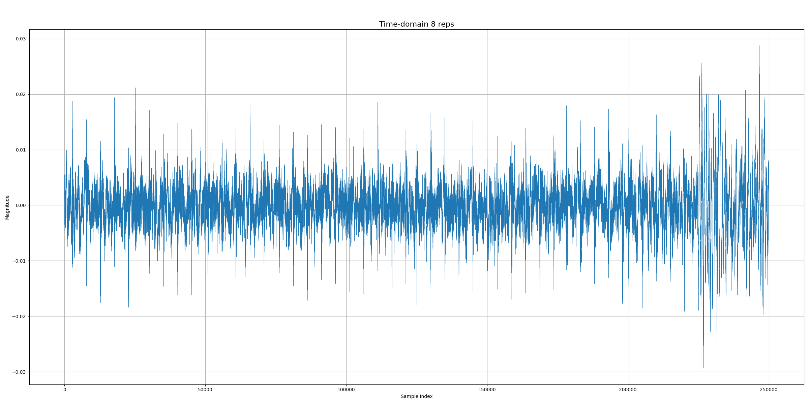
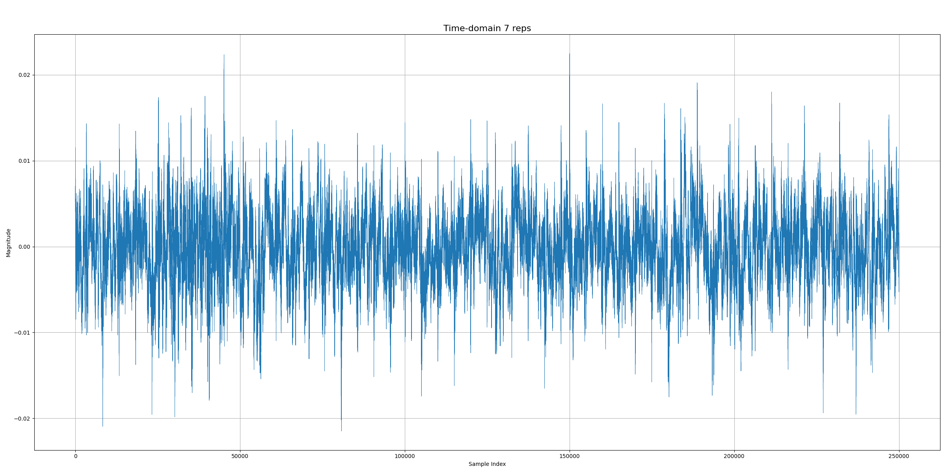
86.5 kHz 7 vs 8 cycles

Slide 5
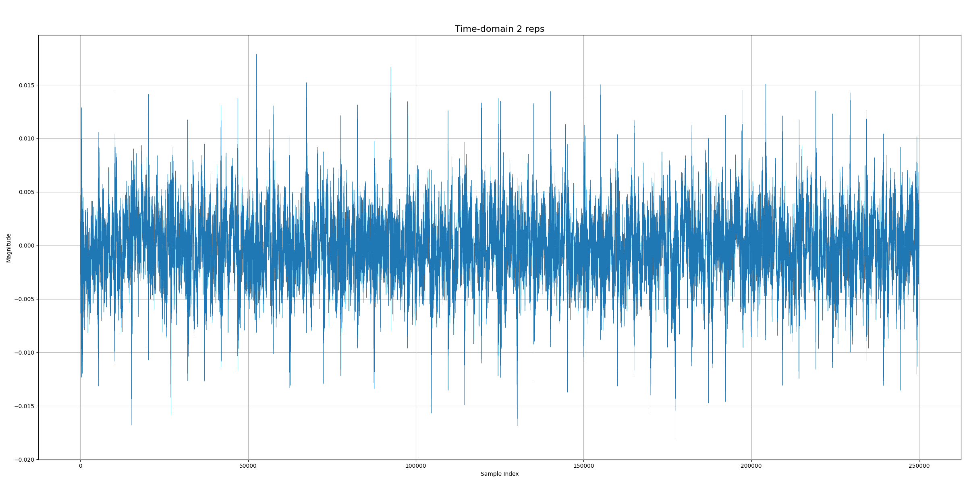
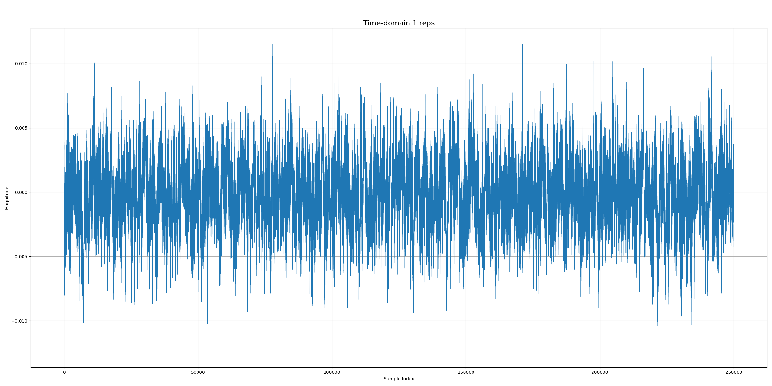
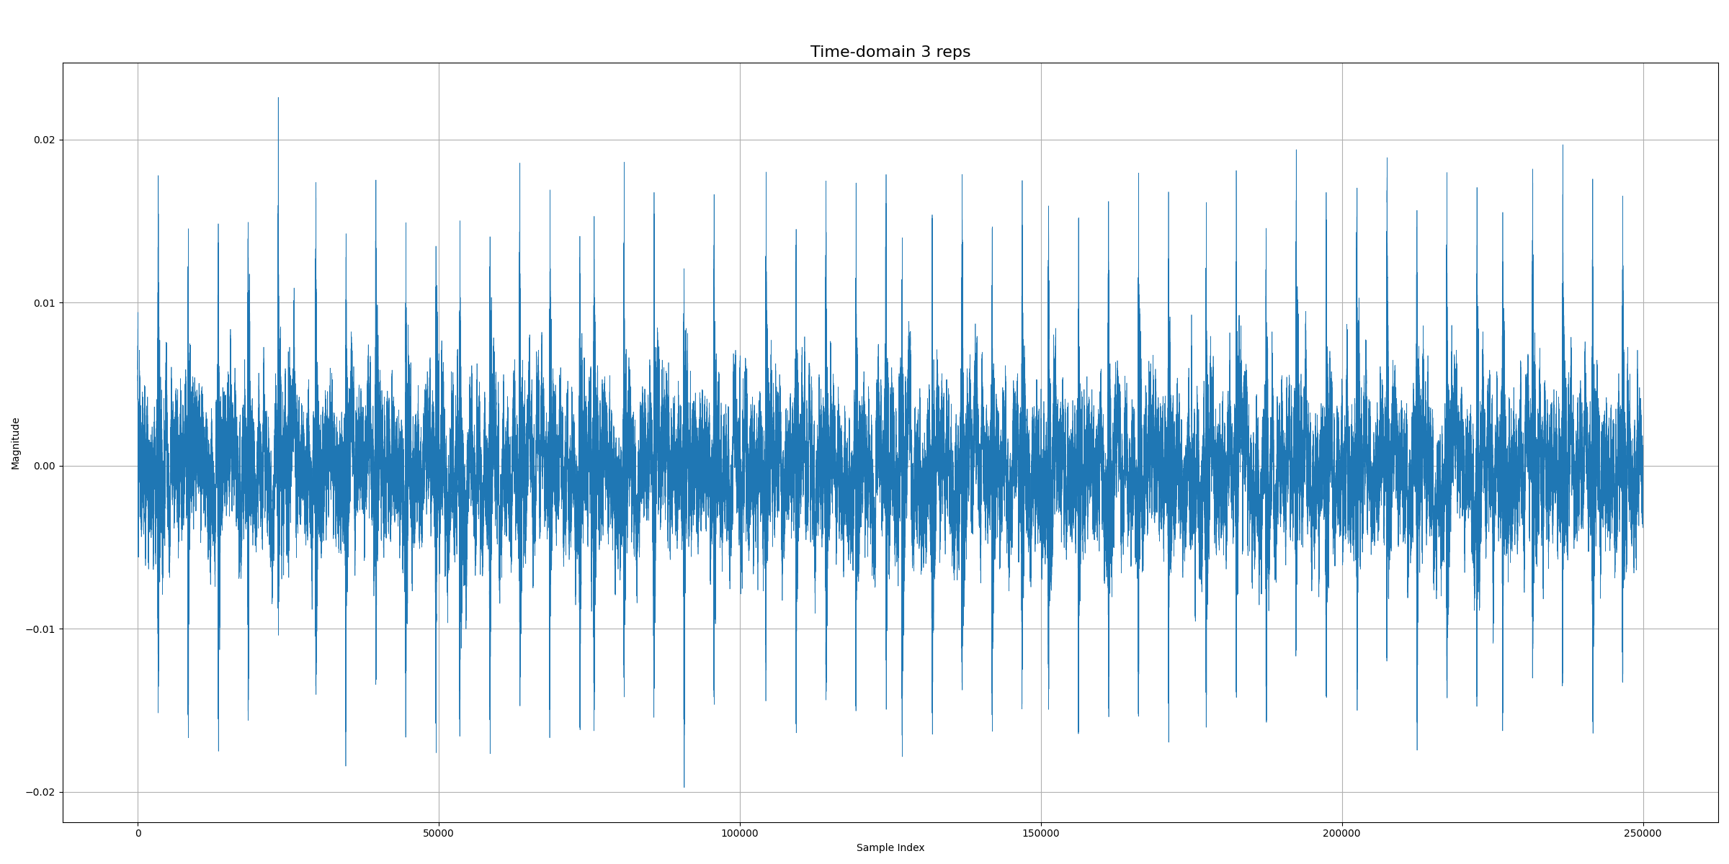
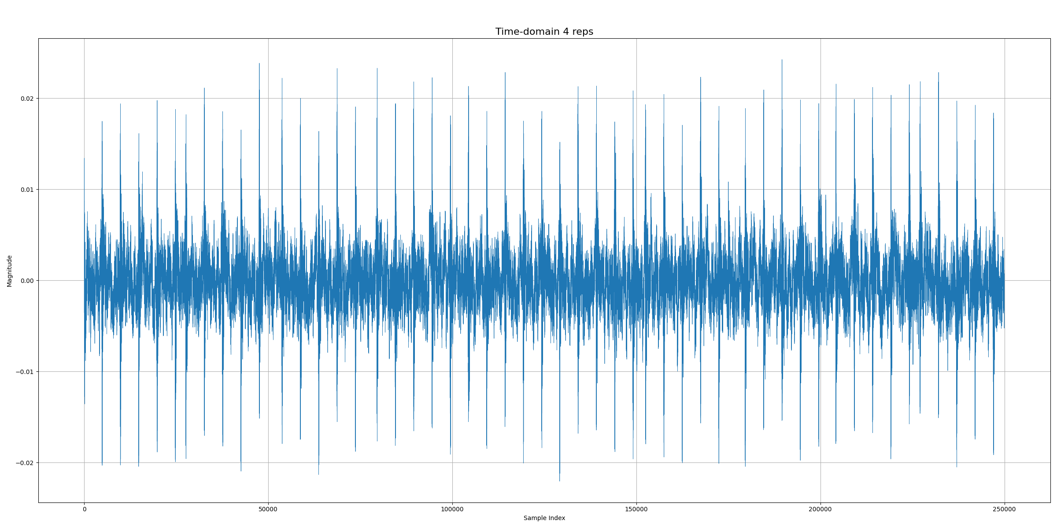
40.4 kHz

Slide 6
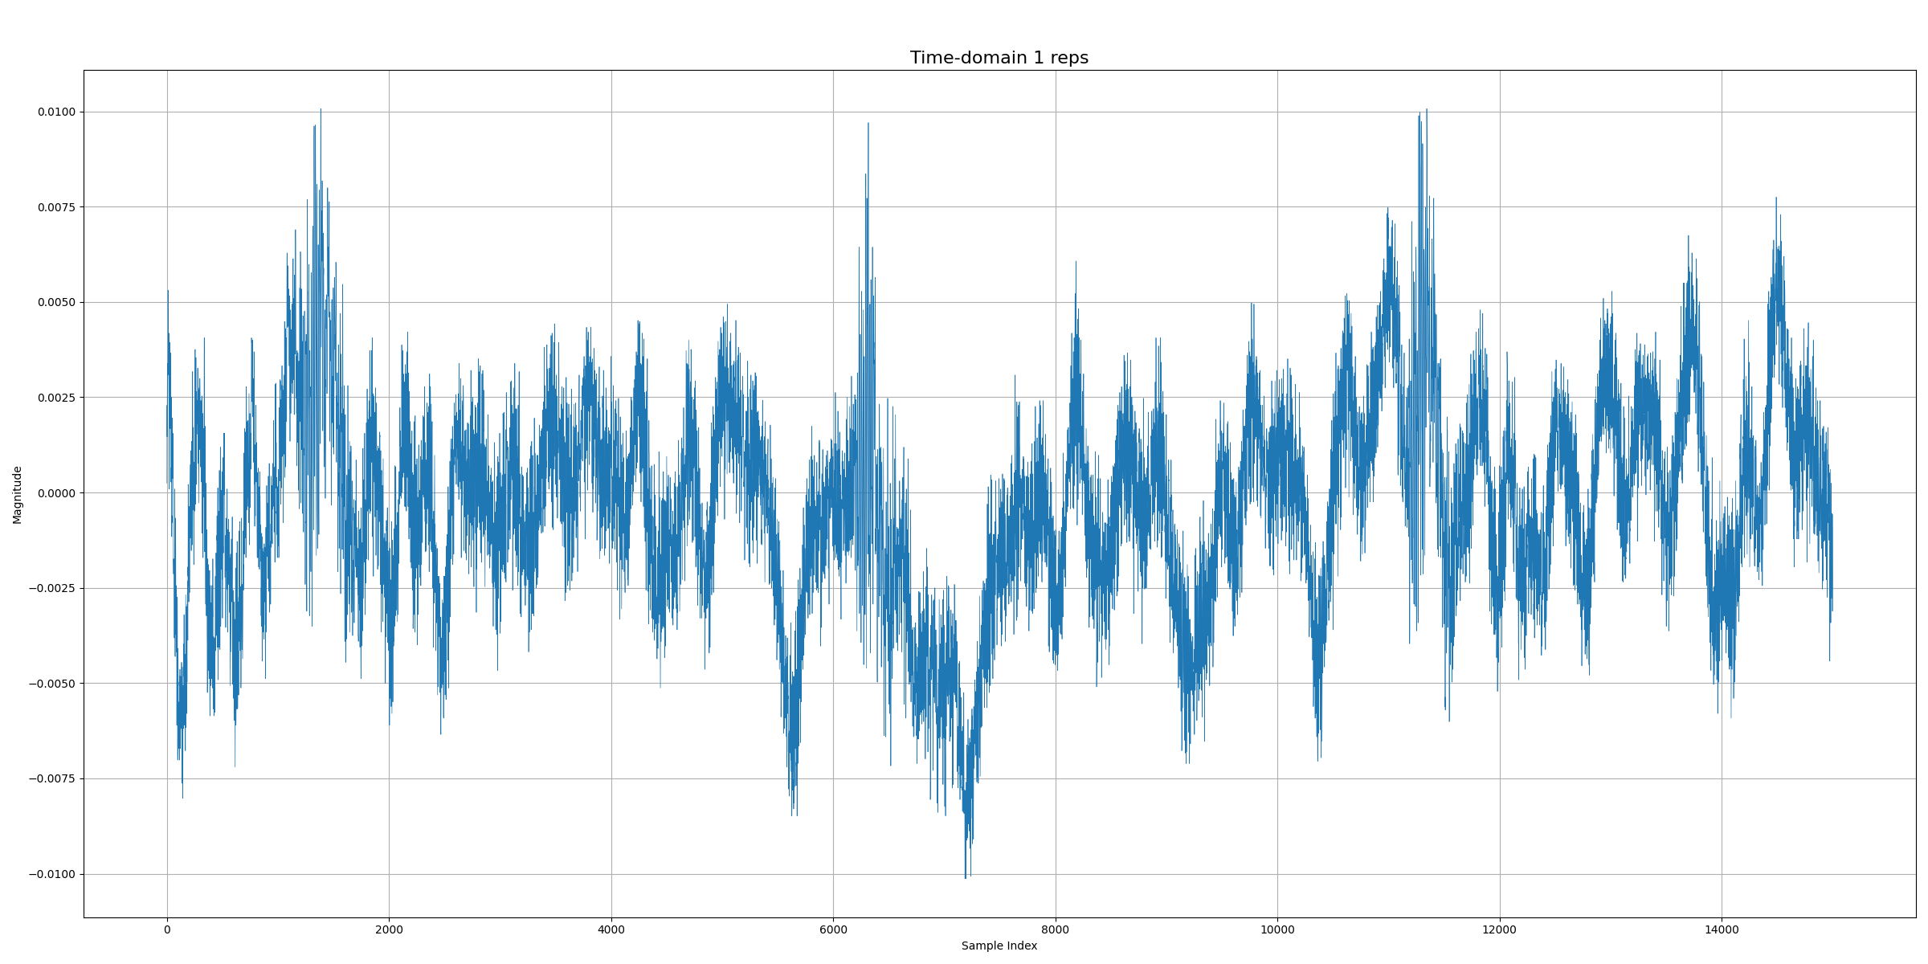
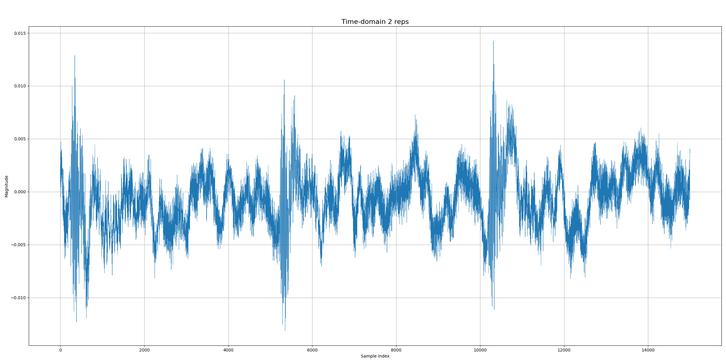
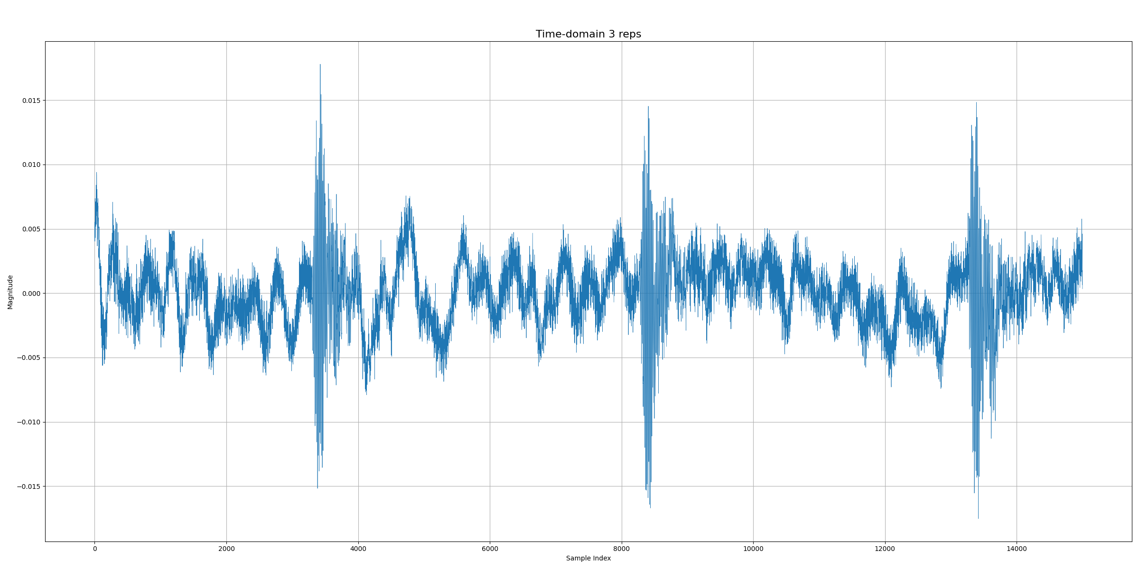
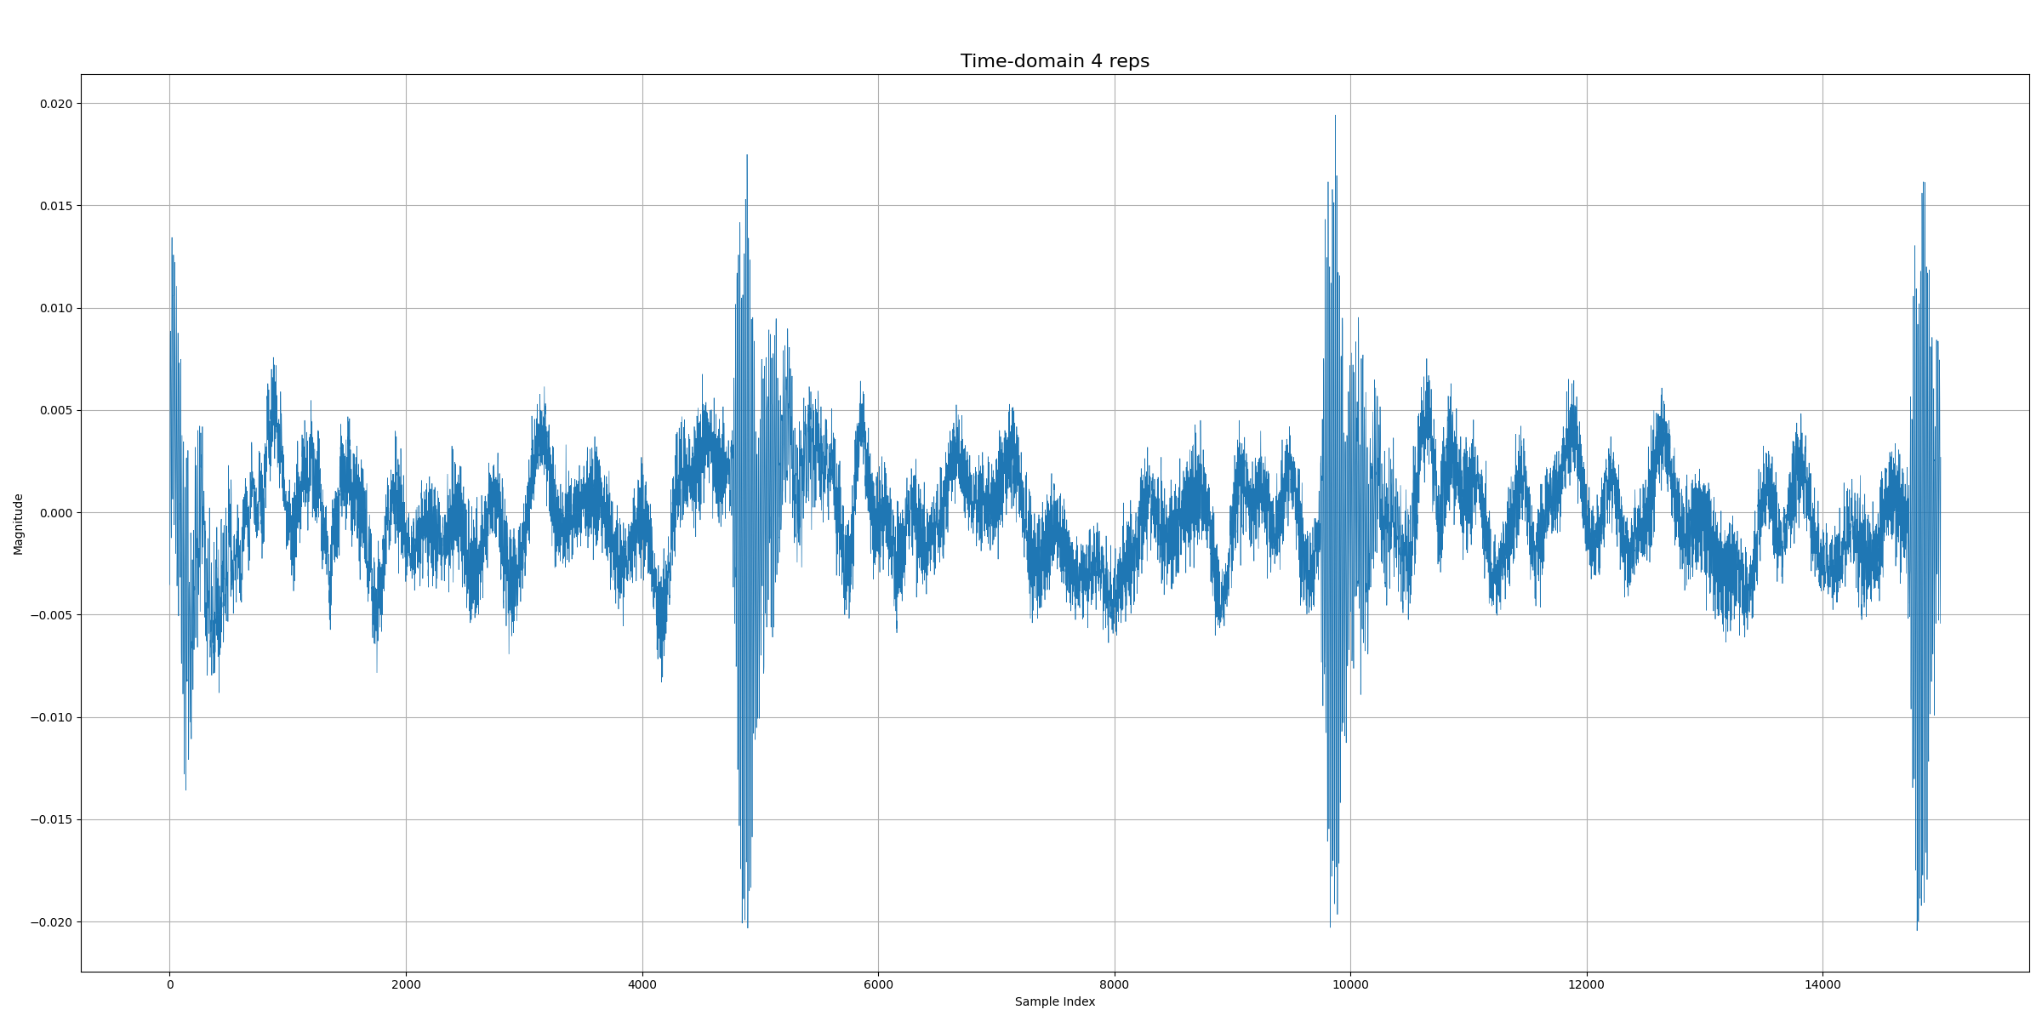
40.4 kHz time-domain zoomed in

Slide 7
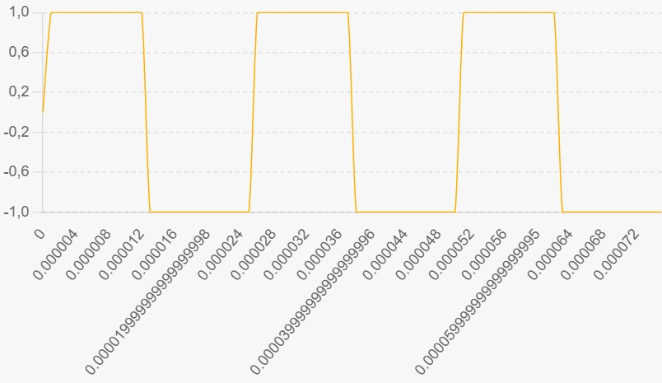
40.4 kHz vs 86.5 kHz
40.4 kHz sound wave distinguishable from 3 cycles: 62.5 microseconds to generate sound
86.5 kHz sound wave distinguishable from 8 cycles: 86.7 microseconds to generate sound
(d_plant)/1500000+(34-d_plant)/343000
Minimum travel time: 65 microseconds

